Slide 1






SERVIR
Connecting Space to Village

Slide 2

SERVIR
Goal: Improve environmental management and resilience to climate change
Objective: Strengthen capacity of government decision-makers and other key stakeholders to integrate earth observation information and geospatial technologies into development decision-making

Slide 3
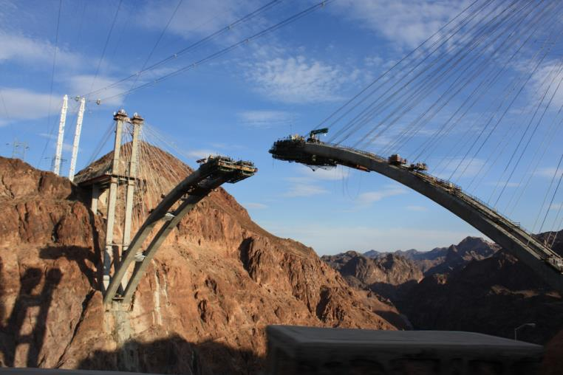
Context
Science
End User
Needs
Improved Development Decision Making
Courtesy: alifayre

Slide 4
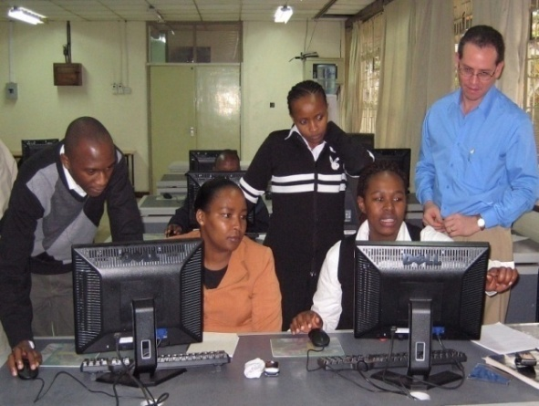
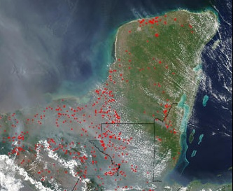
What We Do
Identify needs in SERVIR regions
Link science products from research institutions to meet those needs through improved access to data, models, online maps, and visualizations
Build capacity of regional institutions, stakeholders, and young professionals
Strengthen partnerships and foster collaboration across SERVIR network

Slide 5
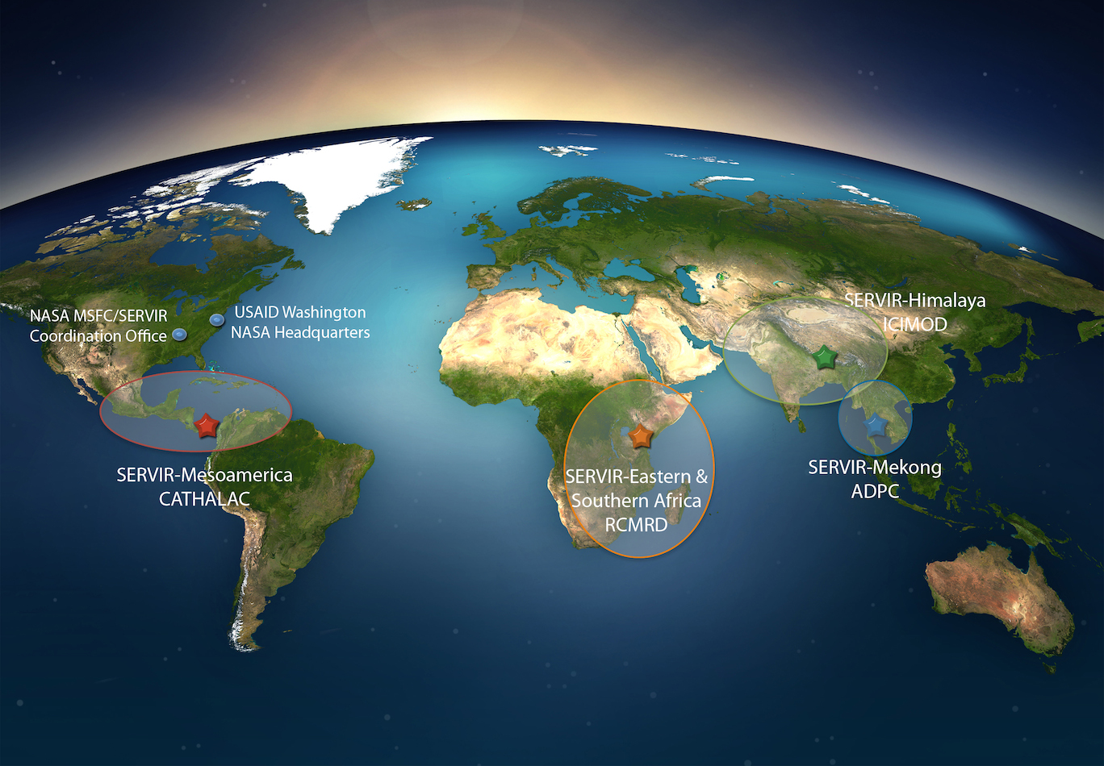
Regional Partners

Slide 6
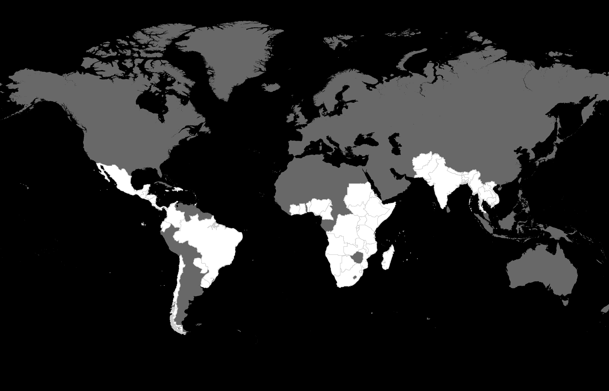
SERVIR Global Geographic Focus
59 Countries with additional SERVIR cooperation
SERVIR Applied
Sciences Teams
SERVIR / MyCOE
Disaster Assessment /
Environmental Analysis
Notes:
But, SERVIR provides services that are broader…

Slide 7
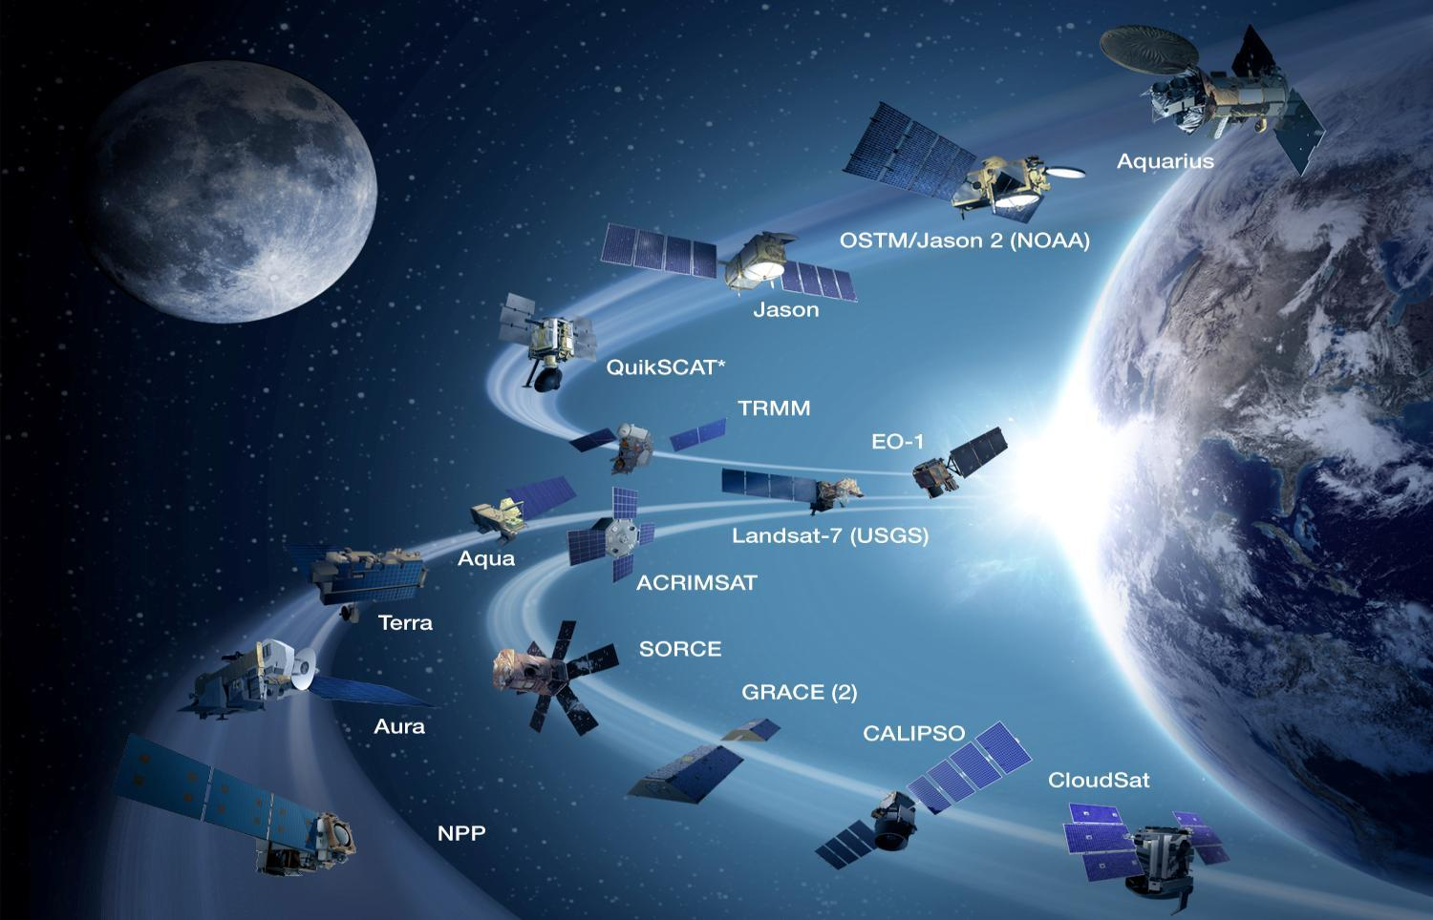


Connecting Space
To Village
|‌ 7

Slide 8
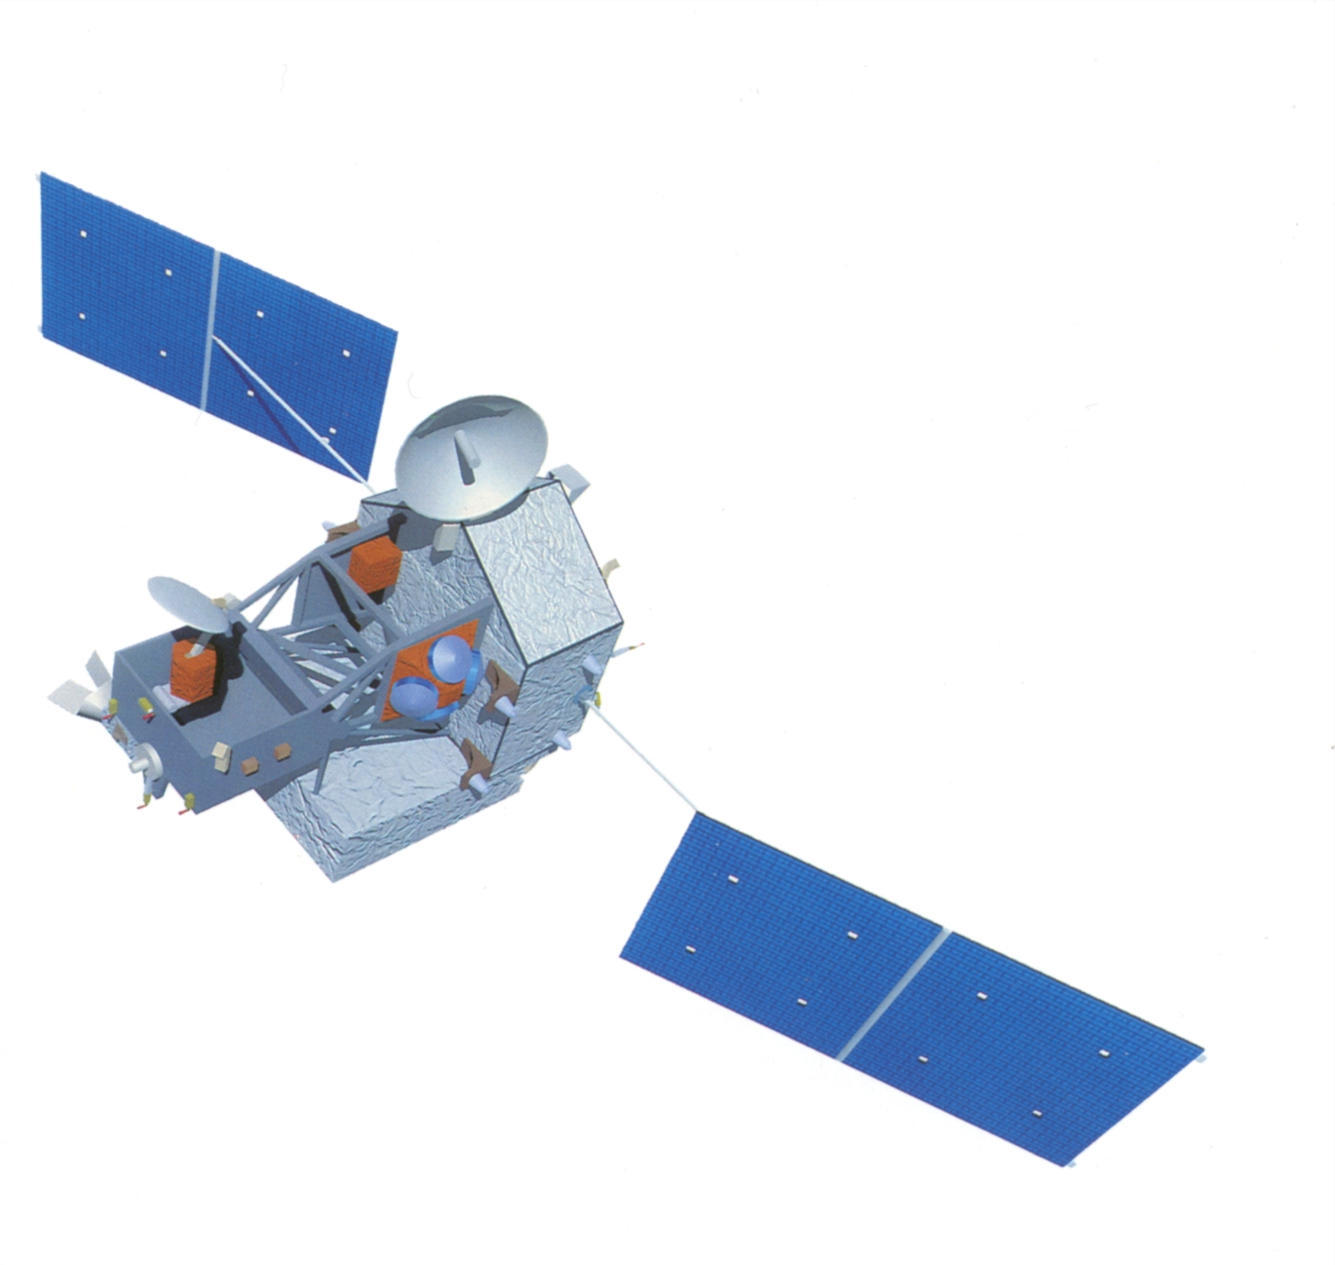
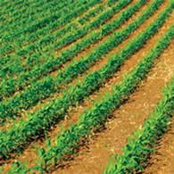

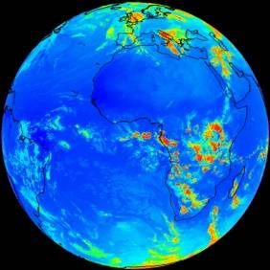
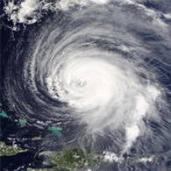
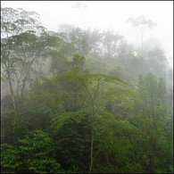
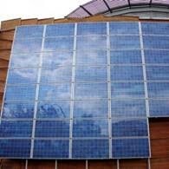



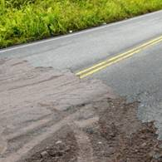

SERVIR Thematic Areas
Agriculture
Biodiversity
Climate
Disasters
Ecosystems
Energy
Health
Water
Weather

Slide 9
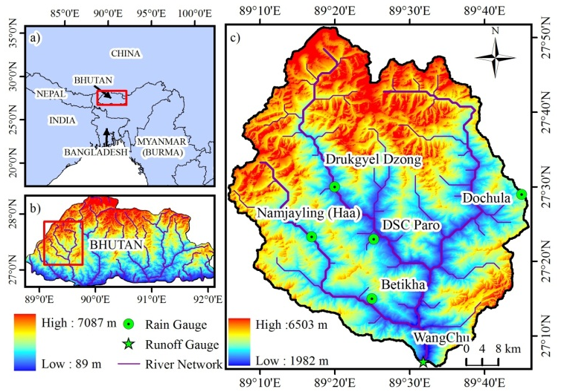
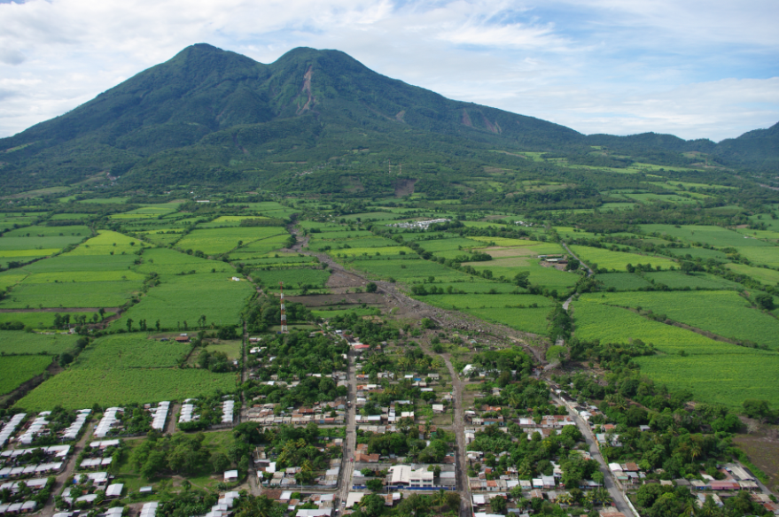
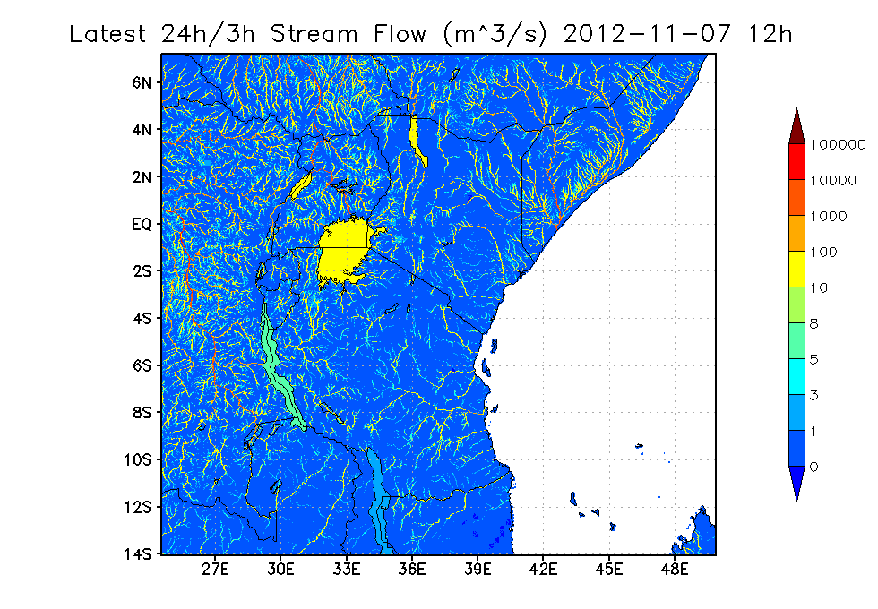
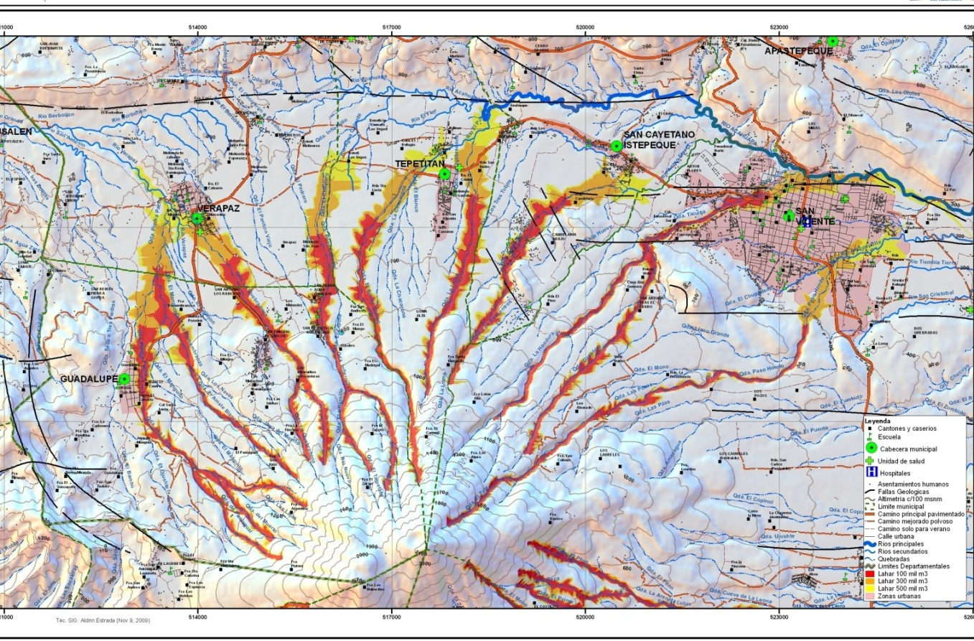
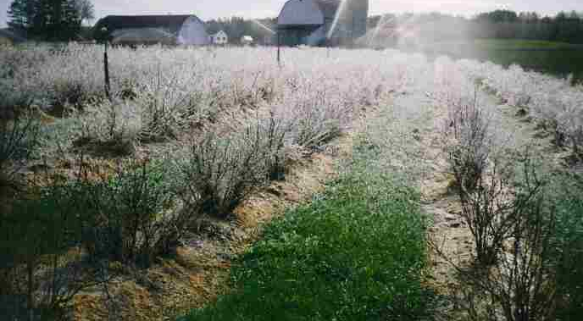
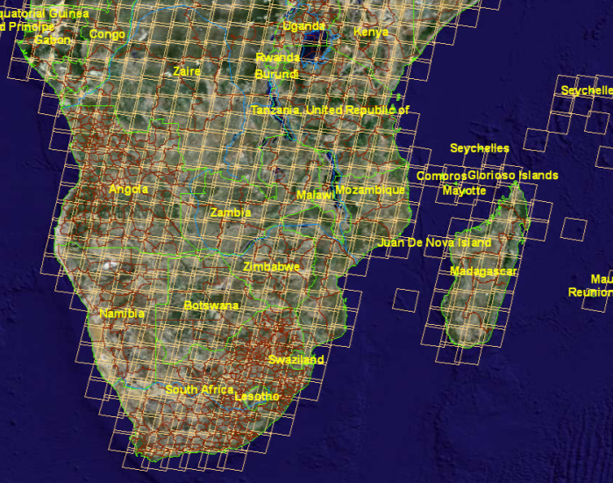
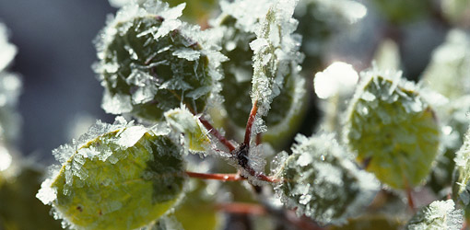
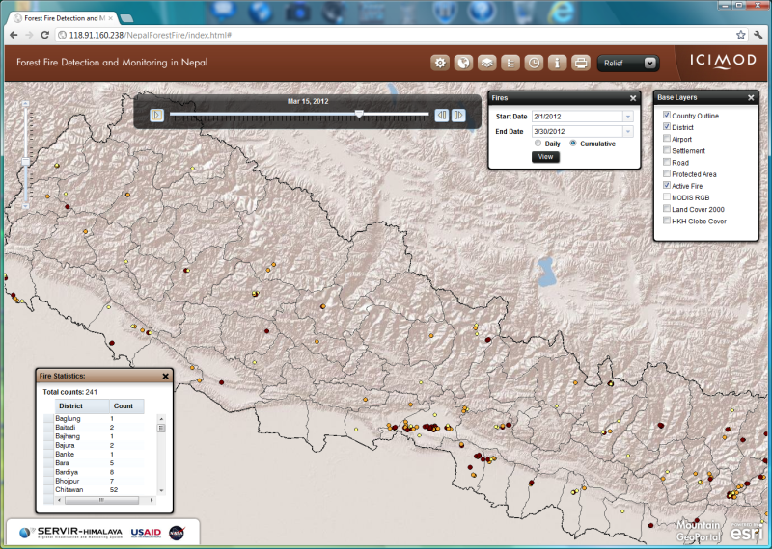
SERVIR Science Applications for Decision Making
Real Time Streamflow in East Africa
Bhutan Water Resource Assessment
Landslide Prediction System in Mesoamerica
Near Real-time Forest Fire Monitoring in Nepal
Frost Mapping in Africa
Greenhouse Gas Emissions Inventory in Africa

Slide 10
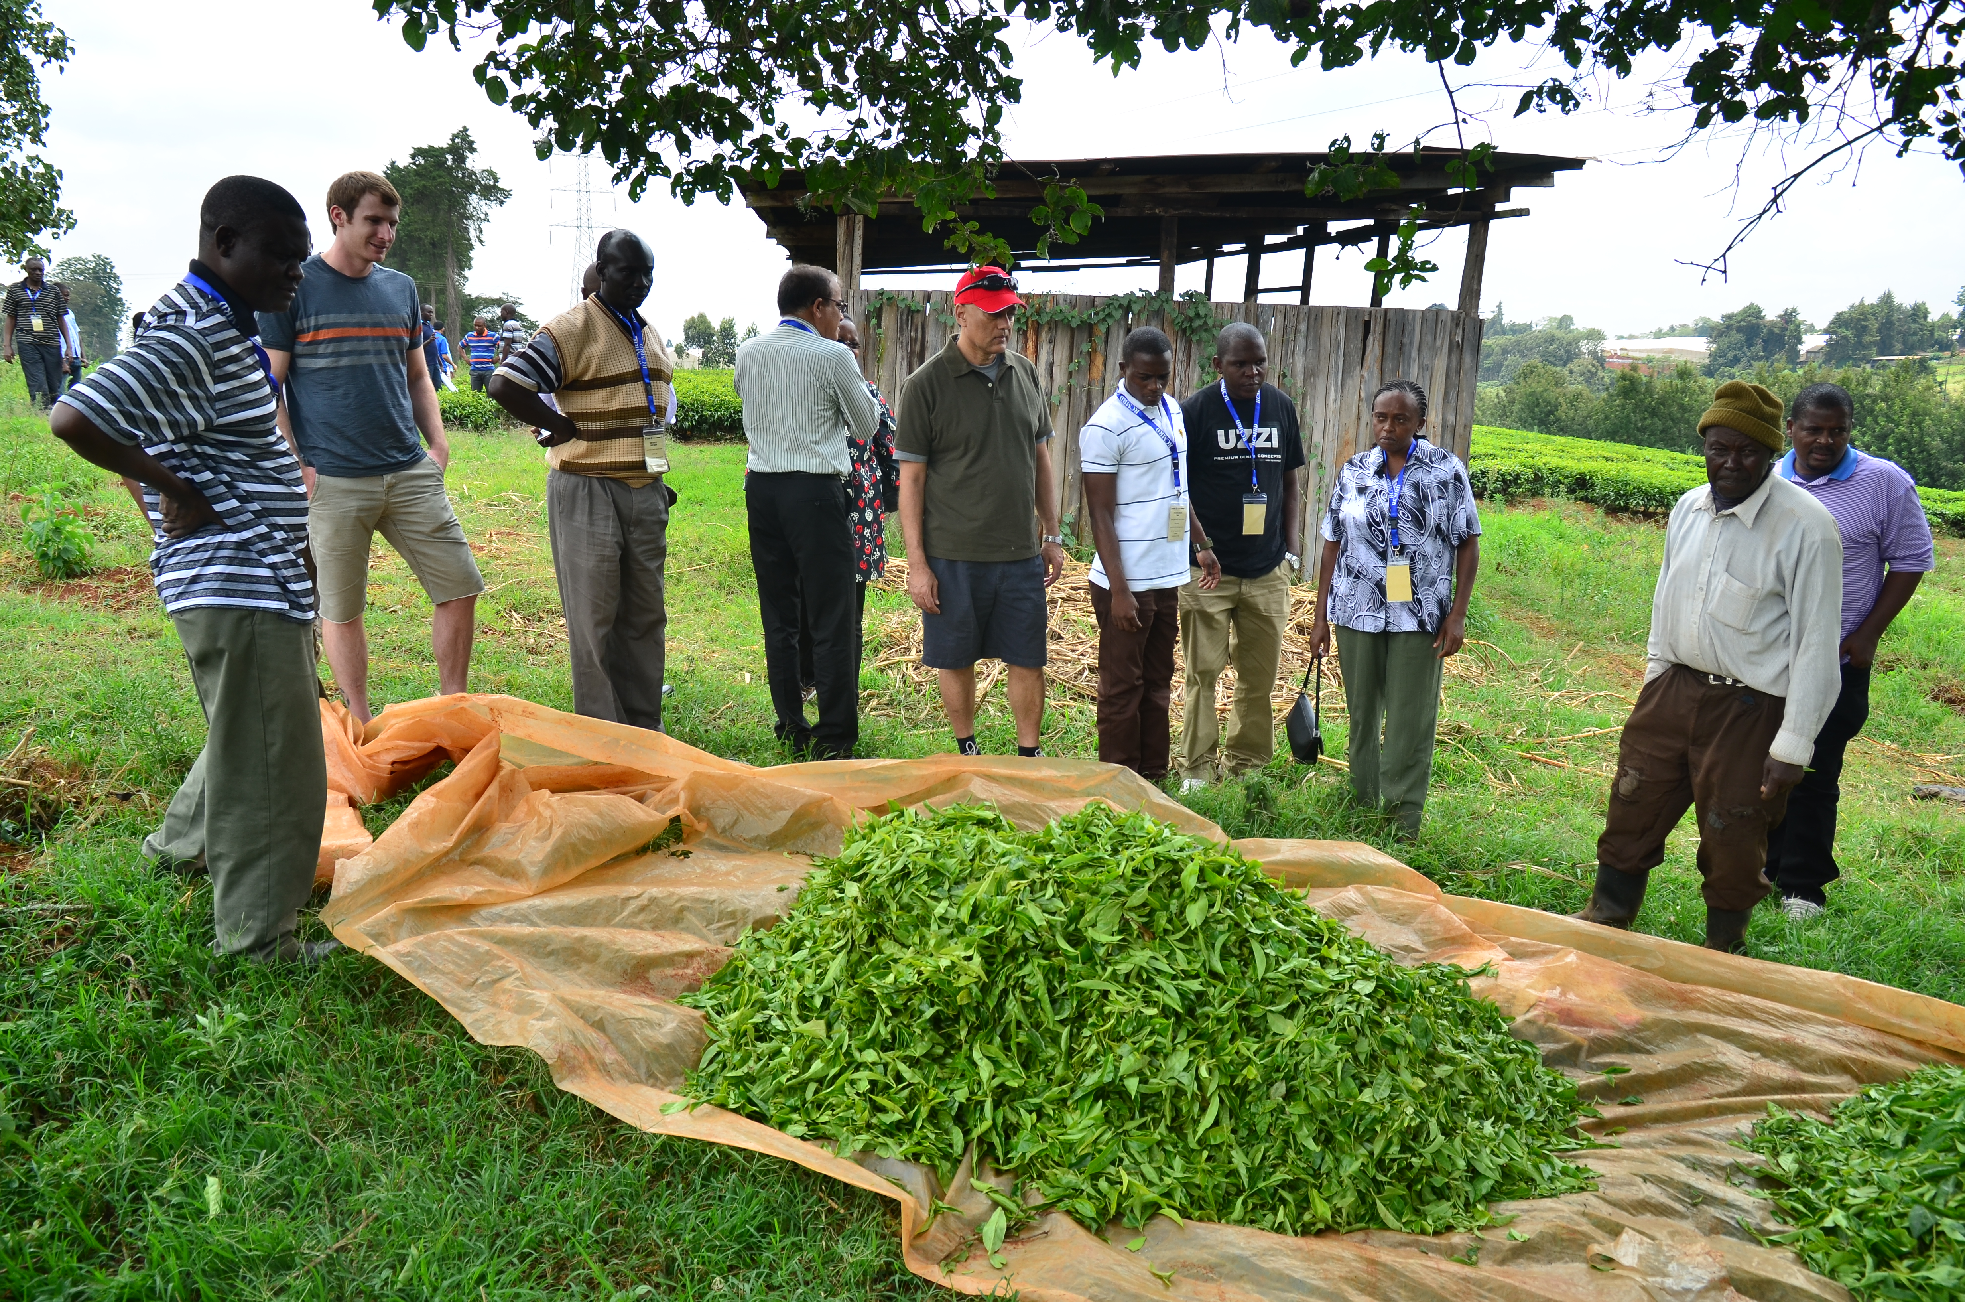
Frost Mapping in East Africa
Tea and coffee are important agricultural commodities in East Africa, providing a living for about 4 million people.
Most farms have sophisticated operations; many have irrigation systems.
Frost occurs infrequently but causes millions of dollars in damage to tea and coffee crops. Farmers do not have a way to know where and when frost might occur.

Slide 11
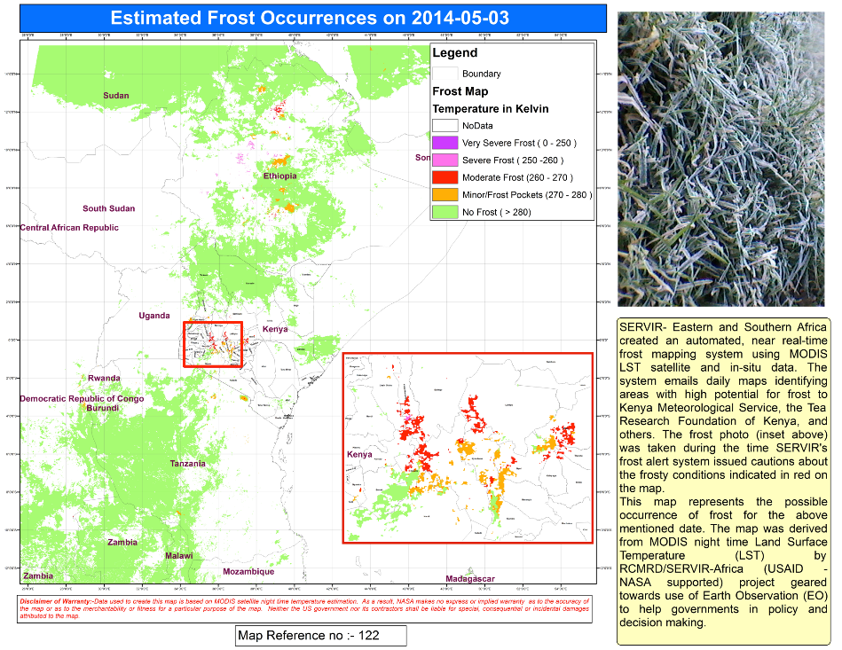
Automated Frost Mapping using MODIS LST
SERVIR Tool: SERVIR created an automated, near real-time frost mapping system using satellite and in-situ data.
The system depended on the LANCE data products, but with the installation of a MODIS receiving station, SERVIR has reduced the product latency to just a few minutes.
The system generates maps identifying areas with high potential for frost, with the thresholds developed with guidance from the Tea Research Foundation of Kenya (TRFK) and Kenya Meteorological Service.

Slide 12
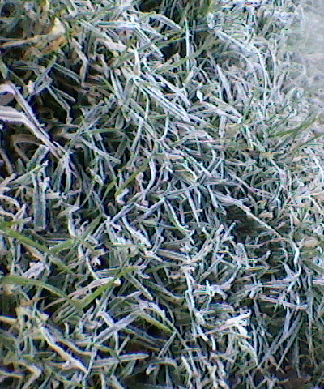
Uses of Frost Mapping
With prior warning, farmers can take preventive measures, such as irrigating the farms, to reduce frost damages.
The system is helping TRFK develop tea cultivation best practices. Tea farmers all over Kenya and beyond depend on TRFK for research improving the quality of tea.
AON Insurance is creating a frost insurance product for East Africa, knowing some quantitative data for the region is available. They plan to use the historical observations as a means to justify crop loss claims.
SERVIR-Eastern and Southern Africa is rolling out an early warning system in collaboration with Kenya Meteorological Service by incorporating their weather forecasts.

Slide 13
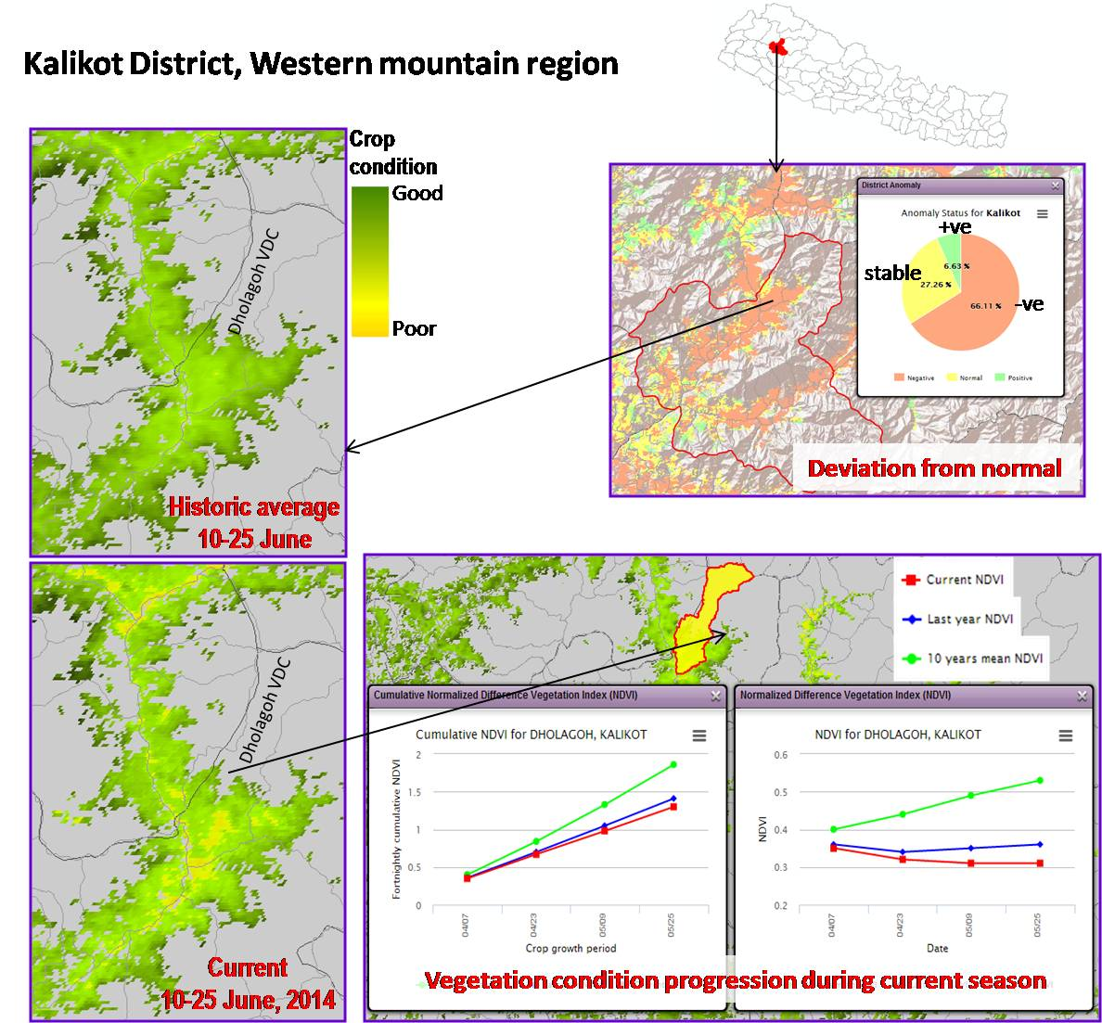
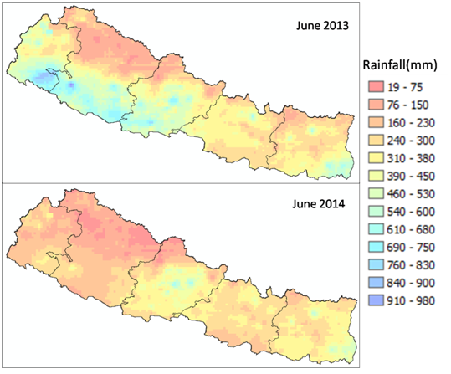
Satellite-based Agricultural Drought Warning System
Problem: Nepal Ministry of Agriculture and Development (MoAD) needed a way to track the agricultural productivity in the country where so many people depend on subsistence agriculture. MoAD requested SERVIR Himalaya’s help to create a drought warning system by tracking the changes in vegetation as an indicator of agricultural productivity.
SERVIR tool: SERVIR, following the technique developed by Famine Early Warning System (FEWS NET), developed a MODIS-derived tool that links the vegetation growth to crop yields in Nepal’s Tarai districts.
`
Results: The tool was used by the ministry this year as the agricultural atlas and tracking tool. MoAD plans to use the tool to provide of timely information on agriculture/drought conditions to the decision maker to enable triggering an appropriate response related to food security.

Slide 14
SERVIR Applied Sciences Projects - Topics
Spanning the Areas of Capacity Building
Air Quality Monitoring
Water Resources mapping
Health & Climate Forecasting
Carbon Emissions Reduction (REDD+)
Glacier & Alpine Hazards
Landslide Forecasting
Drought Prediction
Agricultural Productivity

Slide 15
SERVIR Applied Sciences Team (AST)
PI Last name | Title | Institution | Theme | Region
Laporte | Forest carbon assessment for REDD in the East Africa SERVIR region | The Woods Hole Research Center | Carbon | East Africa
Kargel | Interdisciplinary science applications to glacier and alpine hazards in relation to development and habitation in the Hindu Kush-Himalaya: SERVIR Science Team project | University of Arizona | Disasters | Hindu Kush-Himalaya
Hossain | A Satellite-based Early Warning, Mapping and Post-Disaster Visualization System for Water Resources of Low-lying Deltas of the Hindu Kush-Himalayan region | Tennessee Technological University | Water | Hindu Kush-Himalaya
Verdin | A Long Time-Series Indicator of Agricultural Drought for the Greater Horn of Africa | U.S. Geological Suvey | Agriculture | East Africa
Blackman | Using Earth Observation Data to Improve REDD+ Policy in Mesoamerica and the Dominican Republic | Resources for The Future, Inc. | Carbon | Mesoamerica
Huff | Applications of Satellite Products for Air Quality Monitoring, Analysis, Forecasting, and Visualization in the SERVIR Mesoamerica and Himalaya Regions | Battelle Memorial Institute | Air Quality | Mesoamerica, Hindu Kush-Himalaya
Robertson | Leveraging CMIP5 and NASA / GMAO Coupled Modeling Capacity for SERVIR East Africa Climate Projections | NASA / MSFC | Climate Scenarios | East Africa, Hindu Kush-Himalaya, Mesoamerica
Granger | East Africa Drought and Agricultural Productivity Assessment and Prediction System | Jet Propulsion Laboratory | Disasters, Agriculture | East Africa
Valdes | SERVIR Water Africa-Arizona Team (SWAAT) | The University of Arizona | Water | East Africa
Kirschbaum | Landslide Hazard Assessment and Forecasting System using near real-time remote sensing information over SERVIR-Mesoamerica | NASA Goddard Space Flight Center | Disasters | Mesoamerica
Ceccato | Development and Implementation of Flood Risk Mapping, Water Bodies Monitoring and Climate Information for Disaster Management and Human Health (integration within SERVIR) | Columbia University | Public Health | East Africa

Slide 16

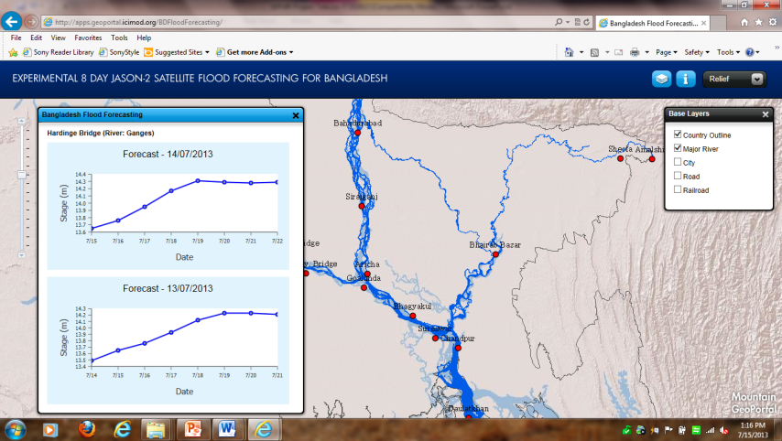
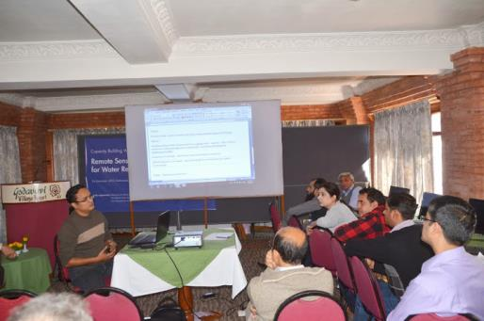
Improved Flood Forecasting using Satellite Altimeters
Problem: Severe flooding in Bangladesh affects millions. The Flood Forecast Warning Center (FFWC) in Bangladesh generates flood forecasts only 3 days in advance (partly due to a lack of data shared by India upstream), which is insufficient time for families and farmers to prepare.
SERVIR tool: SERVIR, in collaboration with FFWC, linked JASON-2 satellite altimetry data to flood forecasts. SERVIR has helped FFWC develop capacity to generate flood forecasts 8 days in advance using this near real-time satellite data.
Results: Bangladesh officials have generated experimental 8-day forecasts accurately representing river levels for the 2014 monsoon season. The Ministry of Water Resources has incorporated SERVIR’s 8-day forecast into the official Bangladeshi forecasting system, providing 160 million citizens with longer lead time. The system accurately predicted a large flood wave earlier than their previous operational system, and was applauded by the Bangladeshi government on national TV.

Slide 17
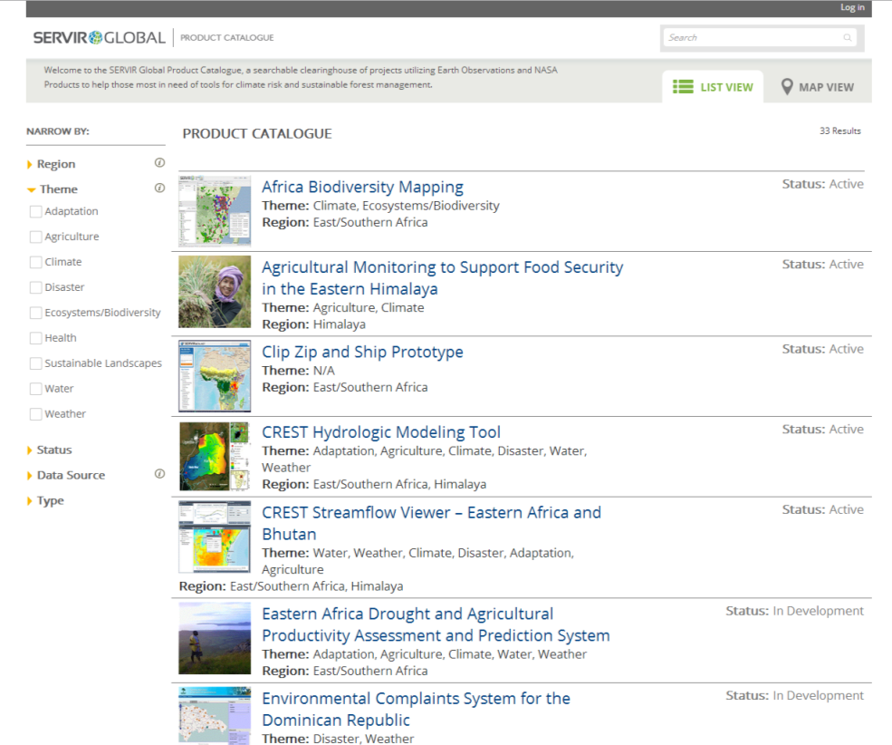
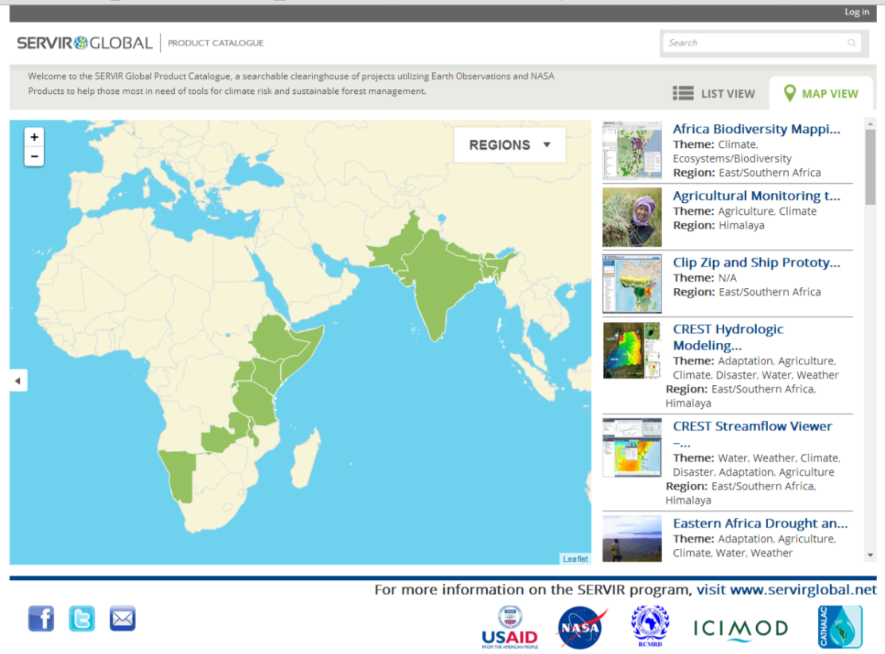
Product Catalogue
SERVIRcatalog.net / SERVIRcatalogue.net

Slide 18
More information:
SERVIR Global: http://www.servirglobal.net
SERVIR CO Contacts:
Daniel Irwin – Project Director
Tia Ferguson – Project Manager
Nancy Searby – NASA HQ Program Manager
Ashutosh Limaye – Project Scientist

Slide 19
Thank you…
Questions?

Slide 20
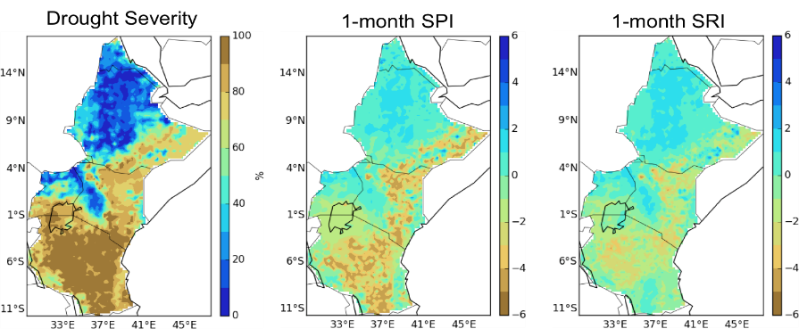
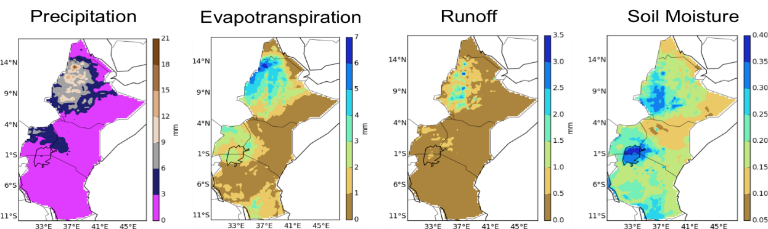
Drought and Agricultural Productivity Assessment and Prediction System
Susceptibility Map
In East Africa, forecasts of end of season crop production estimates are critical. Collaborations with Ministries of Agriculture in Kenya, Ethiopia, and Tanzania have shown that reliable crop productivity assessment tools are critical to effectively address food security challenges.
Goal is to generate drought and crop productivity nowcasts and forecasts using the best available ground- and satellite-based data and a coupled hydrologic - crop productivity model suite called RHEAS.
Maize and wheat models are complete, and the ground validation has proven effective capture of the crop yield trends. Next steps are complete transition of the tool to end users.
Hydrologic outputs from RHEAS
July 2011 maps of drought products

Slide 21
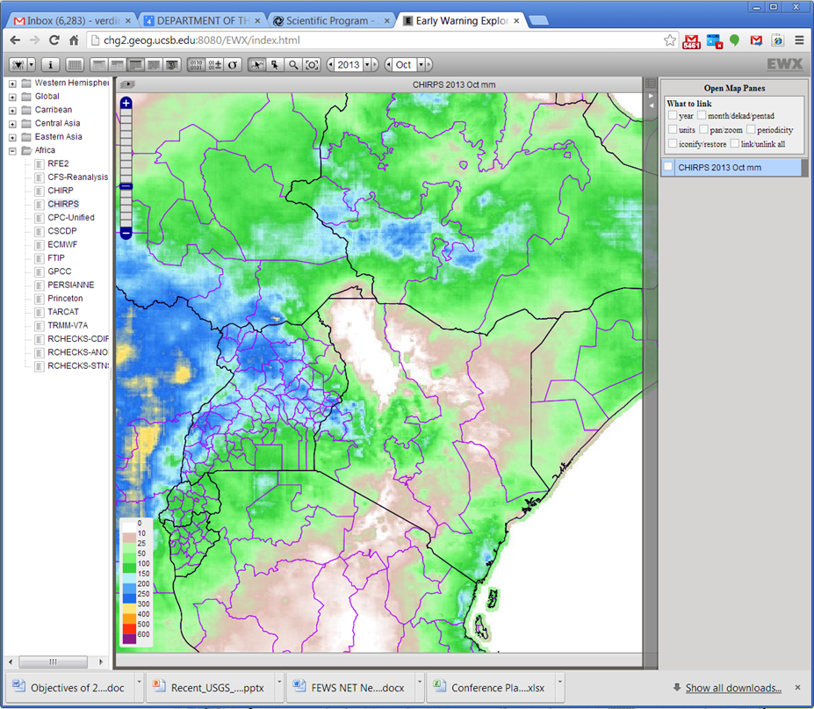
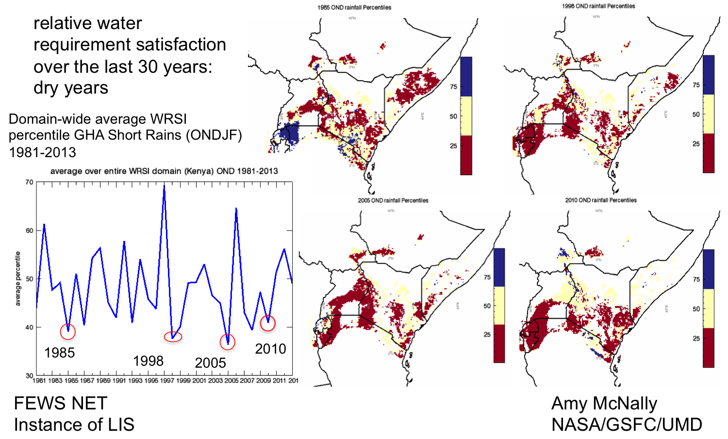
Long Time-Series Indicator of Agricultural Drought
for the Greater Horn of Africa
Drought assessment is dependent on a consistent climatology of rainfall.
Using satellite data, numerical weather model products, and ground observations, SERVIR has created a 30-year climatology of rainfall. The 5-daily, 0.05° spatial resolution data is available for the entire globe.
The USGS-FEWS NET water resource satisfaction index is being applied to East Africa to generate a long time series of drought indicator. The methodology is versatile and has been applied in several parts of the world.
CHIRPS data in the EWX web interface
WRSI for East Africa

Slide 22
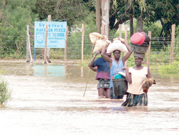
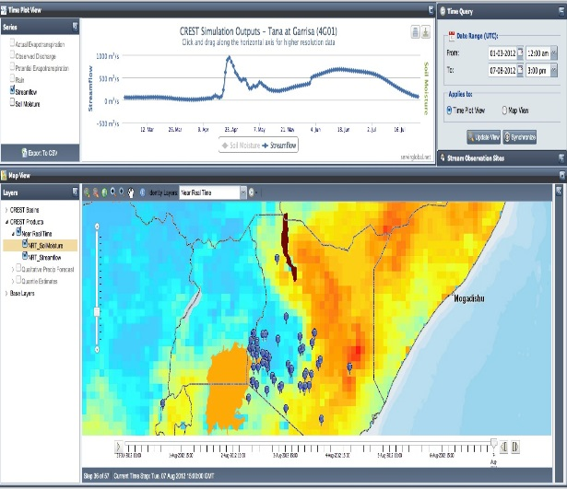
CREST Model Use in Kenya, Uganda, Namibia, and Rwanda
In this collaboration with Ministry of Water in Kenya, Rwanda, Namibia, and Uganda, the hydrologic modeling system uses satellite rainfall and a distributed hydrologic model to quantify streamflow.
Inputs | Climatic data-precipitation (NRT and forecasts), evapotranspiration Observed daily stream-flow data Topographical data - DEM, flow direction, flow accumulation and scientists ( CO & RCMRD)
Outputs | Calibrated CREST model as a flood forecasting system for the priority basins Trainings for capacity building Near real-time alert system through email to water authorities
Outcomes | Increased number of stakeholders using the CREST tool for decision making to reduce the impacts of climate change
Impact | Mitigation measures put in place in flood-prone areas Flood management policies developed
End Users | Stakeholders from Water ministries in Kenya, Uganda, Namibia, and Rwanda

